Slide 1
Final Project – Choosing the best Algorithm Introduction to Data Analysis (DATA 1200) Prof. Ritwick Dutta
Dheer Parikh
100919437

Slide 2
Introduction
In this assignment we have to choose the best model for Mr. John for student’s change in standardized score after training using dataset `Happy_Dataset.csv`
In this dataset personal details such as cost of living, trust in police, maintenance of street and sidewalks, overall quality of public schools and availability of public services are given.

Slide 3
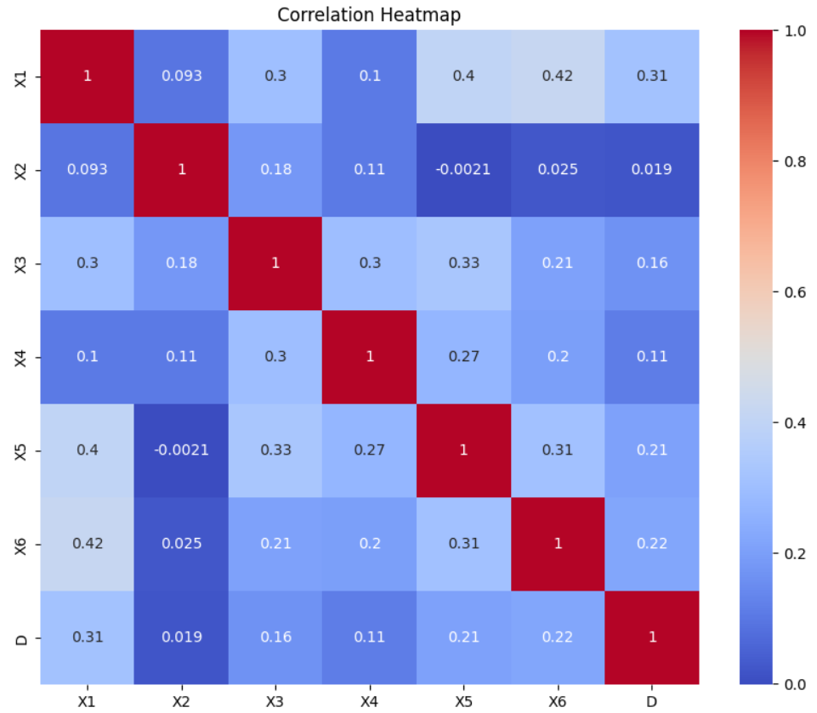
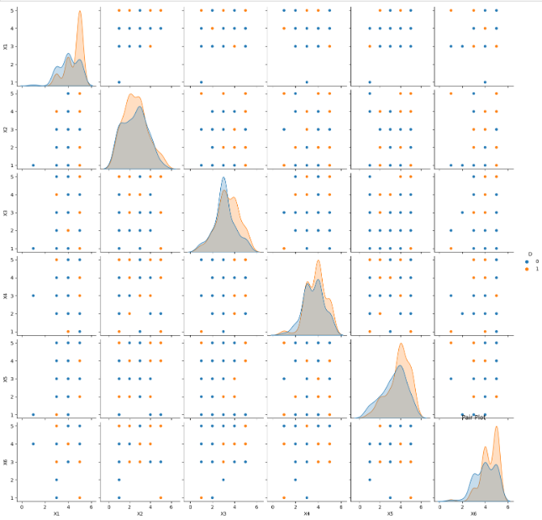
Understanding dataset:
Correlation Map
Pair plot
From the correlation map it can be seen that the features are not linearly related to each other.
From the pair plot it can be seen that the distribution of data is not normalized.
It can be seen that the data for `unhappy` is not as much as `happy`

Slide 4
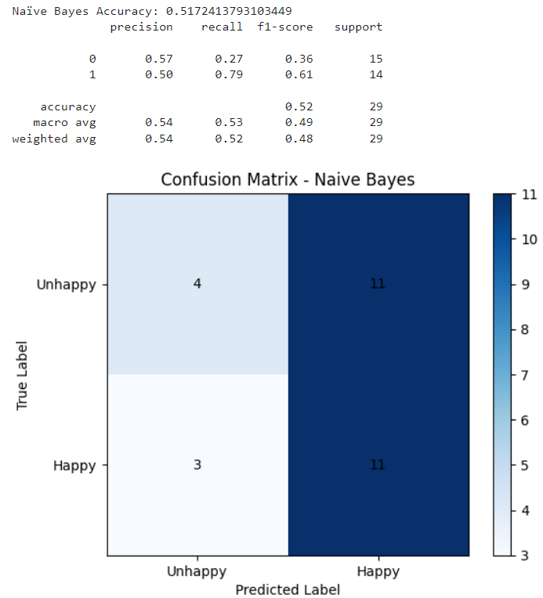
Interpretation of Naïve Bayes:
Performance Matrices
Confusion Matrices
Naïve Bayes model is more biased towards predicting `happy` as an outcome.
The accuracy of the model is very less.
The F-1 Score of predicting `Unhappy` is also very less.

Slide 5
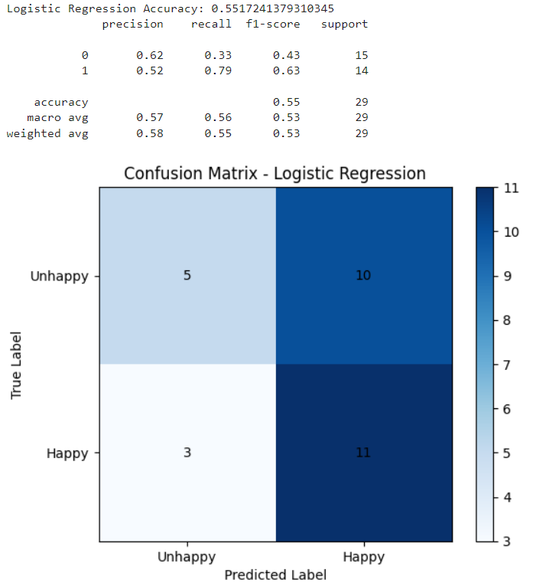
Interpretation of Logistic Regression:
Performance Matrices
Confusion Matrices
The accuracy of logistic regression is slightly higher than Naïve Bayes.
This algorithm is also more biased towards predicting `happy`.
It is notable that, for predicting `Unhappy` is higher than predicting `happy`.

Slide 6
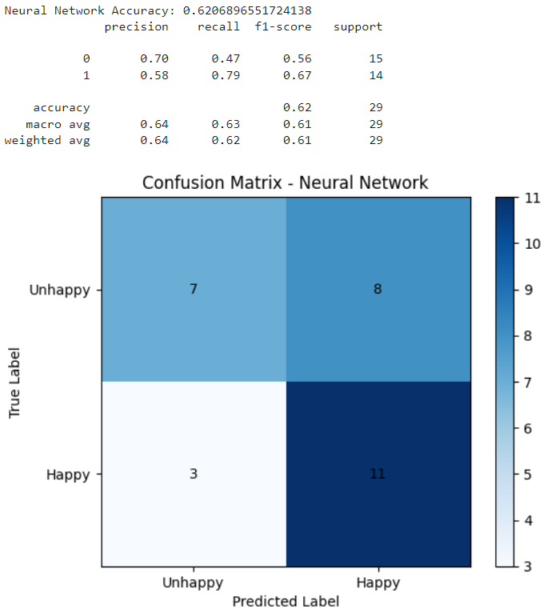
Interpretation of Logistic Regression:
Performance Matrices
Confusion Matrices
The accuracy of Neural network is the highest among all.
This model has predicted most number of correct output which has `Unhappy`.
The precision of `Unhappy` is highest among all.

Slide 7
Recommendations & ways to improve model:
From the analysis it can be recommended to Mr. John to deploy Neural Network algorithm as it is most accurate, precise and most importantly less biased towards `happy`.
More data should be collected.
More algorithms such as KNN should be tried.
More optimized neural network by tuning hyperparameter

